Slide 1
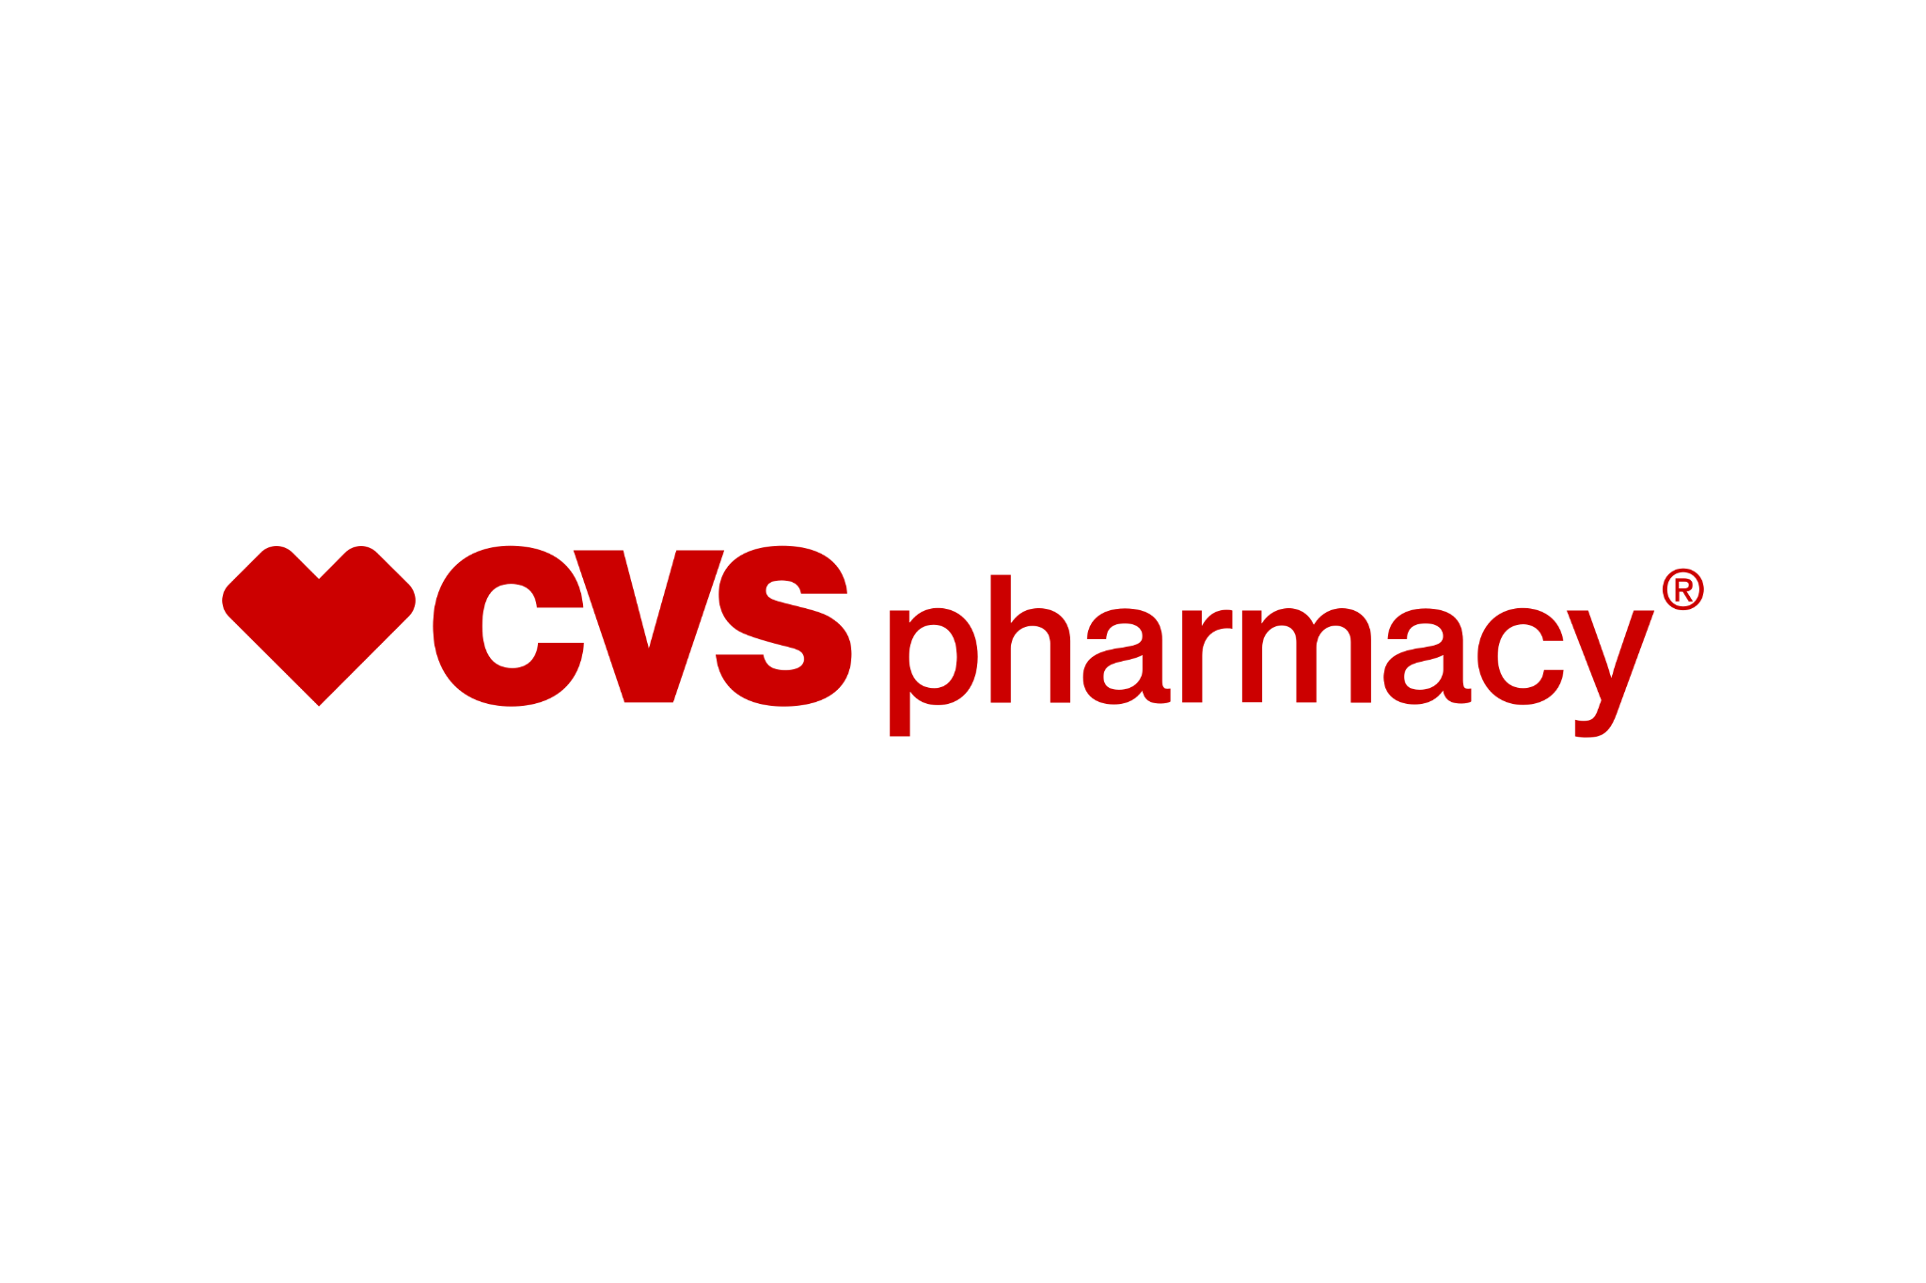
Building Healthy Data Infrastructure
LINDSAY BARTOL, SAMEER KHAN, FEMKE MUNTING, TWINKLE PANDA, KUSH PATEL, ISHA VERMA

Slide 2
Agenda
Company & Data Strategy
Company Overview
Data Strategy
Data Architecture
Data Collection, Analytics & Insight, and Monetization
OLTP Systems
OLTP: Appointment Booking System
OLTP: Inventory Management System
OLTP: Prescription Management System
Data Warehouse
Semi-Structured and Unstructured Data
Data Governance & Authorization
Conclusions

Slide 3
Company & Data Strategy

Slide 4
Company Overview: CVS Pharmacy
CVS Pharmacy is a Market Leader
As the largest pharmacy chain in the United States, CVS Pharmacy boasts approximately 10,000 physical locations, where customers can fill prescriptions, purchase over-the-counter health products and general merchandise, and access wellness services.
Company Environment
Operations
Competition
CVS Pharmacy is a subsidiary of CVS Health, which is divided into four segments:
Health Care Benefits
Health Services
Pharmacy & Consumer Wellness
Corporate/Other
CVS Pharmacy encompasses the business operations of the Pharmacy & Consumer Wellness segment, which include:
Dispensing prescriptions
Retail operations
Administering vaccinations
Diagnostic testing
CVS Pharmacy faces high levels of competition from companies like:
Walgreens
Rite Aid
Walmart
Kroger
Amazon’s pharmacy division

Slide 5
Data Strategy: A Dual Approach
CVS Pharmacy’s data strategy should focus on maintaining a largely defensive approach in order to protect sensitive health information, while also balancing an offensive approach to remain competitive within the dynamic retail and pharmacy sector.
Defensive Approach
Offensive Approach
A defensive approach is necessary in the healthcare industry to safeguard patient information. Therefore, CVS Pharmacy should focus on robust encryption, access controls, and real-time monitoring systems to ensuring data security and integrity.
Additionally, operational efficiency can be achieved by creating a single source of truth (SSOT) for critical information such as patient records, supplier data, and inventory. This approach minimizes risks of data leakages and mismatches, ensuring seamless and secure operations.
CVS must also leverage data offensively to remain a leader within the competitive landscape. This can be done by analyzing consumer behavior to generate actionable insights.
To accomplish this, CVS should also employ multiple versions of truth (MVOTs) for a certain range of data.

Slide 6
Data Architecture
Architecture
Purpose
Options for Tools
Data Analytics and ML
extract actionable insights
AWS SageMaker, Azure ML, or Google AI
Data Marts
segment data by domain & cater to specific needs
Snowflake or Google BigQuery
store processed data
Data Warehouse
Security and Real-Time Analytics
ETL Pipeline
extract raw data, transform it, and load it into structured storage solutions
Apache NiFi or AWS Glue
store structured and unstructured data
Amazon S3 or Google Cloud Storage
Data Lake

Slide 7
Data Collection, Analytics, & Monetization
Data Collection
Analytics & Insights
Monetization
CVS Pharmacy can utilize a number of different channels to harvest data:
Prescription data
Vaccination data
Retail purchases
Customer profiles
Loyalty program data
Website activity
Social media activity
Customer support
Public health data
CVS Pharmacy can employ advanced analytics and machine learning tools to create actionable insights:
Anticipate customer needs
Improve inventory forecasting
Optimize marketing strategies
Optimize supply chains
Optimize staffing models
By leveraging data and analytics, CVS pharmacy can increase its profitability:
Improve customer retention
Recruit new customers
Enhance customer engagement
Precisely predict demand
Reduce supply chain and operational inefficiencies

Slide 8
OLTP Systems

Slide 9




1. Appointment Booking System
Appointment History
Ensures all appointments made by patients are stored for future tracking.
Enable easy retrieval of patient history, appointment trends, and follow-up needs.
Branch & Doctors Details
Enables tracking of all appointments made at a specific branch, providing insights into the branch's demand, doctor availability, and overall patient capacity.
Helps manage doctor availability and schedules effectively
Health History Monitoring
Patient health data can be recorded and easily accessed by doctors with just one click

Slide 10
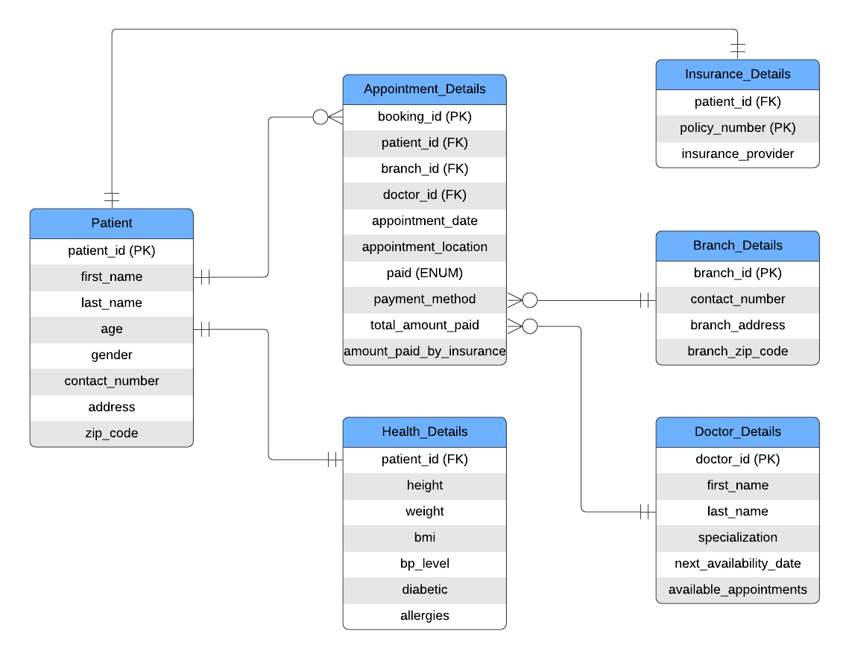
1. Appointment Booking System
Components
1. Patients Table
2. Appointment Details Table
3. Branch Details Table
4. Doctor Details Table
5. Health Details Table
6. Insurance Details Table

Slide 11
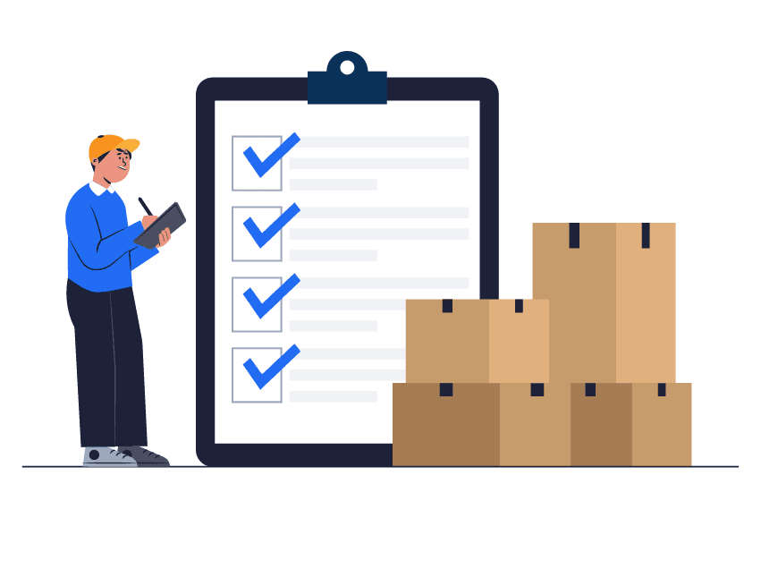
2. Inventory Management System
An inventory OLTP system is essential for a pharmacy for ensuring efficient Supply Chain Management through the following:
Order Processing
Manages concurrent order processing across multiple stores
Tracks order fulfillment from placement to completion
Insights into demand patterns
Stock Level Monitoring
Prevents stockouts
Enables real-time tracking of quantity_on_hand against reorder_level thresholds
Facilitates automated reordering when inventory reaches reorder levels

Slide 12
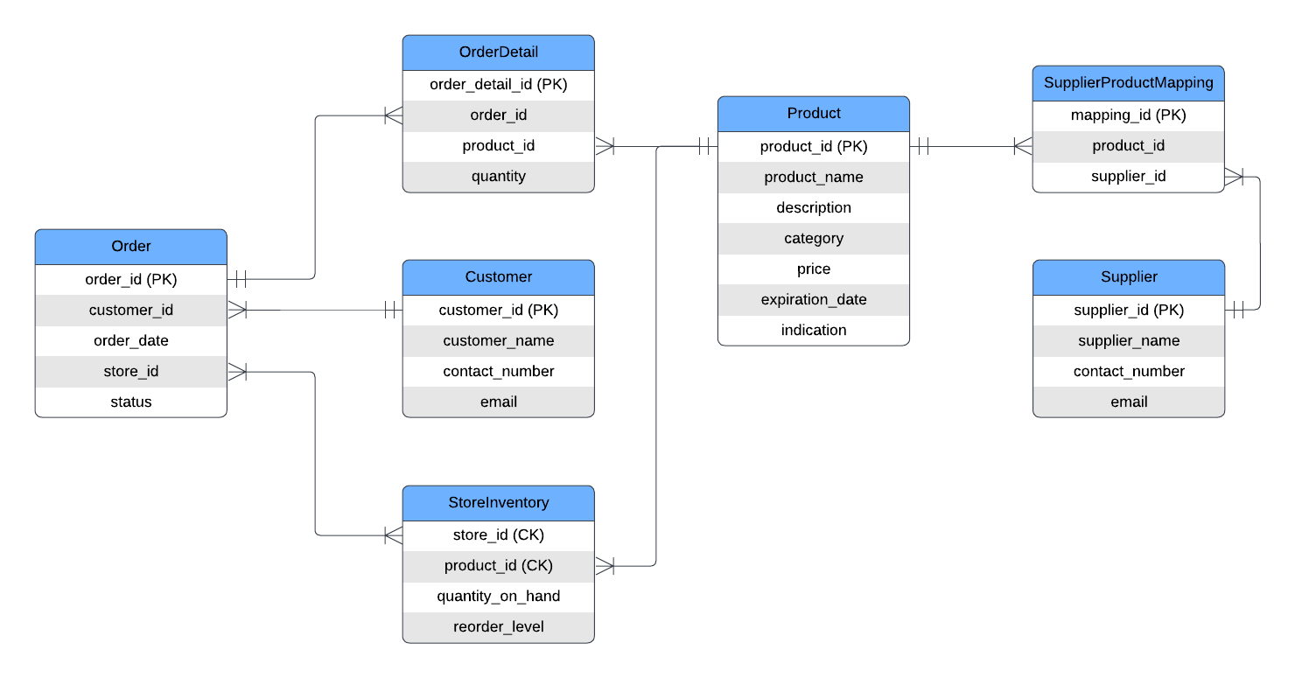
2. Inventory Management System
Components
1. Products Table
2. Store Inventory Table
3. Suppliers Table
4. Orders Table
5. OrderDetails Table
6. Supplier Product Mapping Table
7. Customers Table** Deriving insights like customer purchase pattern

Slide 13

3. Prescription Management System
Prescription and Medication Management
Tracks prescriptions, linked medications, quantities, and statuses via the Prescription and Prescription_Medications tables.
User and Security Oversight
Manages users, roles, and actions with the Users and Audit_Log tables, ensuring security and compliance.
Pharmacy and Transaction Operations
Handles pharmacy details and tracks prescription transactions with the Pharmacy_Data and Pharmacy_Transactions tables.
This system ensures seamless prescription handling, medication availability, and secure operations.

Slide 14
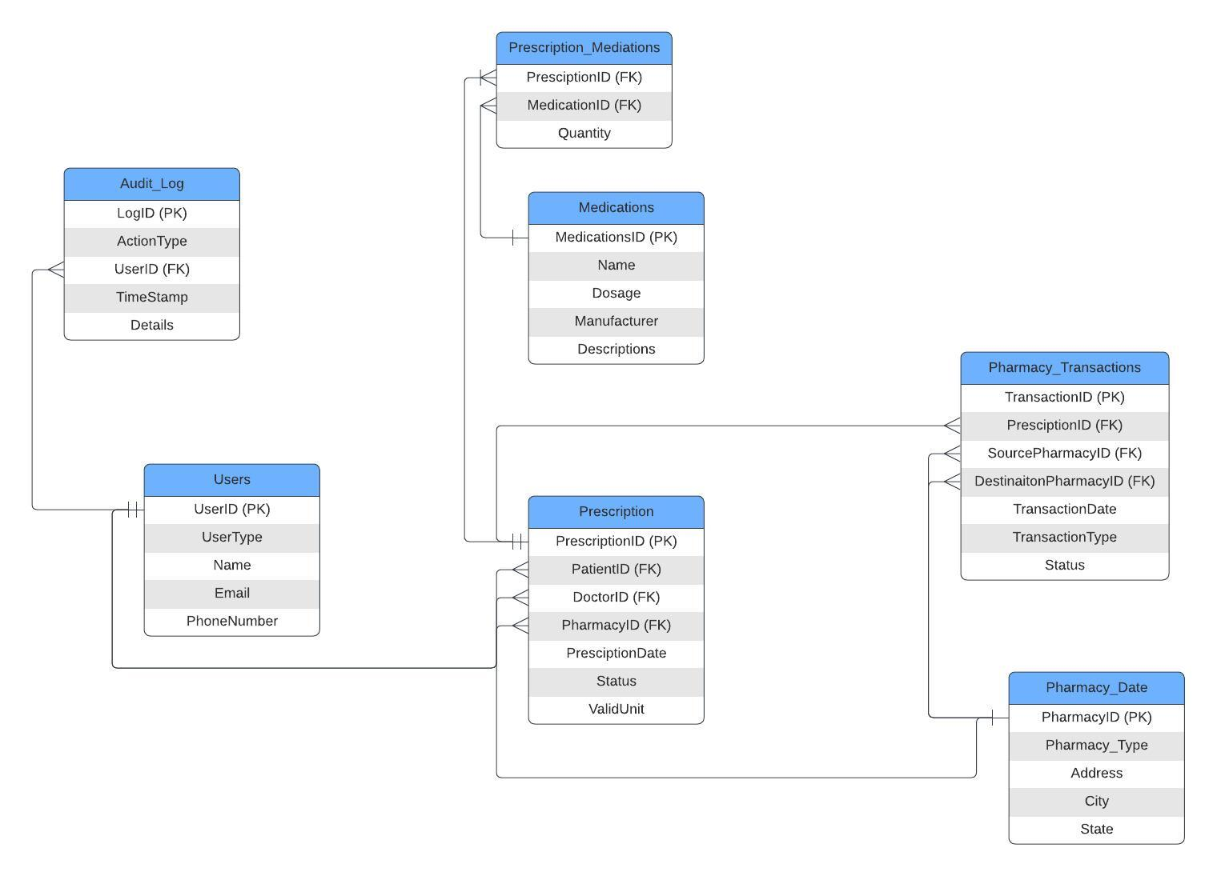
3. Prescription Management System
Components
1. Users
2. Audit_Log
3. Precription_Medications
4. Medications
5. Prescription
6. Pharmacy_Transactions
7. Pharmacy_Data

Slide 15
Data Warehouse

Slide 16
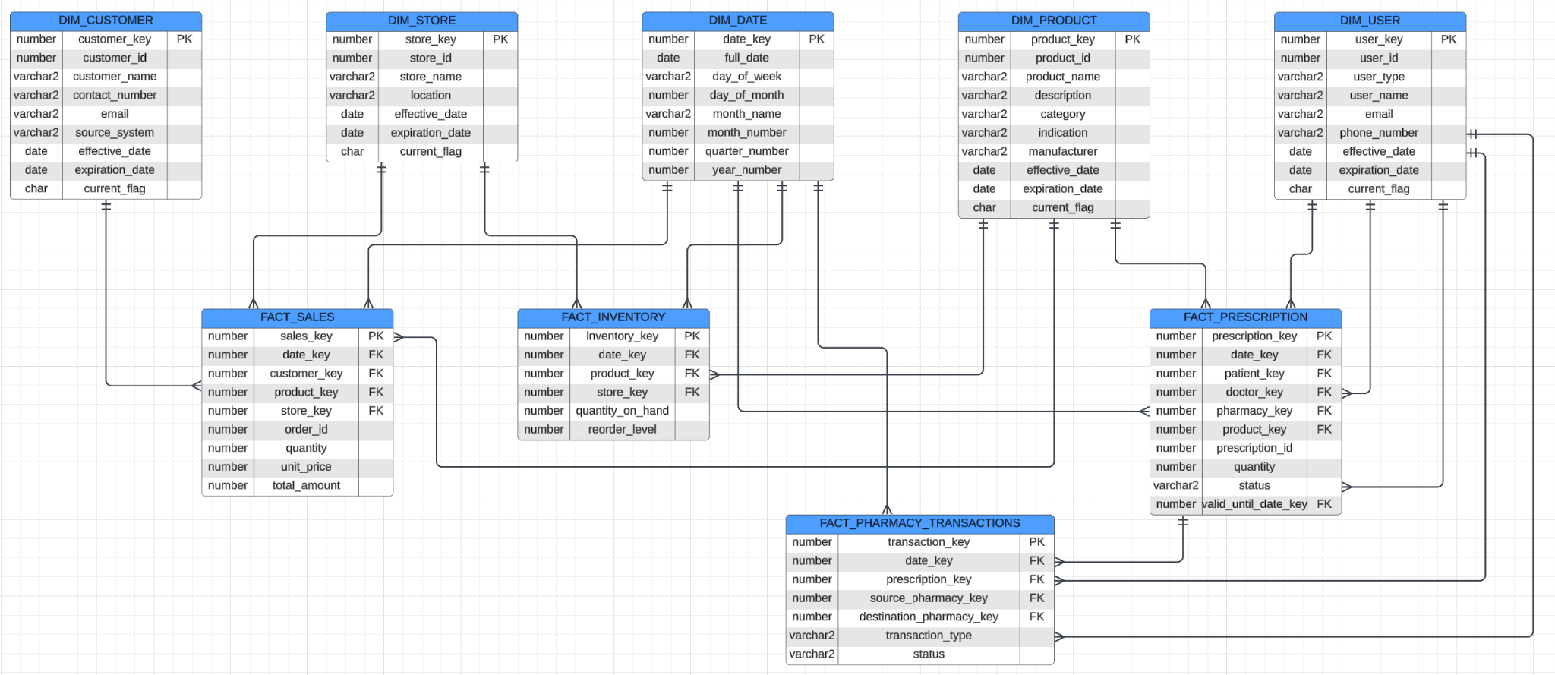
Normalized Enterprise Data Warehouse
Components
1. DIM_DATE
2. DIM_CUSTOMER
3. DIM_PRODUCT
4. DIM_STORE
5. DIM_USER
6. FACT_SALES
7. FACT_INVENTORY
8. FACT_PRESCRIPTION
9.FACT_PHARMACY_TRANSACTIONS

Slide 17
Sample Query for the Data Warehouse
SELECT
dp.product_name,
ds.store_name,
SUM(fs.total_amount) AS total_sales_amount,
SUM(fs.quantity) AS total_quantity_sold
FROM
FACT_SALES fs
JOIN
DIM_PRODUCT dp ON fs.product_key = dp.product_key
JOIN
DIM_STORE ds ON fs.store_key = ds.store_key
JOIN
DIM_DATE dd ON fs.date_key = dd.date_key
WHERE
dd.year_number = 2023 AND dd.quarter_number = 4
GROUP BY
dp.product_name, ds.store_name
ORDER BY
total_sales_amount DESC
FETCH FIRST 5 ROWS ONLY;
Product Name | Store Name | Total Sales Amount | Total Quantity Sold
Pain Relief 500mg | Main Street CVS | $12,500 | 1,250
Multivitamin Gummies | Downtown CVS | $10,200 | 1,020
Children’s Cough Syrup | Elm Street CVS | $9,800 | 980
Cold & Flu Capsules | City Center CVS | $9,500 | 950
Heartburn Relief Tablets | Uptown CVS | $8,700 | 870
Query:
Find the top 5 products by total sales amount in the last quarter of 2023, along with the corresponding store names and total quantities sold.

Slide 18
Semi-Structured & Unstructured Data

Slide 19
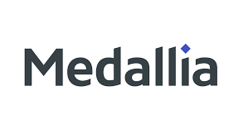



Unstructured Data
Customer feedback surveys through Medallia
Valuable information in free-response
Handwritten doctor’s notes
Transcribing and rewriting is time-consuming and error prone

Slide 20
Data Governance + Authorization

Slide 21



01
02
03
Critical
Risk Areas
Cyberattacks
Physical Hardware
AI Training

Slide 22
FEDERATED DATA GOVERNANCE
Individual databases coordinated under a single data governance and privacy policy framework
CVS Health Subsidiary Partners
SHARED MODEL TRAINING
Partnering with other CVS Health subsidiaries, e.g. Aetna, CVS Caremark
Different levels of privacy requirements:
Prescription
Over-the-counter
Wellness products
Demand for non-prescription goods could be better predicted by partnering with other departments
Improved customer segmentation without sharing individual data
SECURITY MEASURES
CVS Pharmacy could learn valuable information from other CVS Health subsidiaries such as Aetna
Encryption
User authentication
Synthetic data for analyses
Logging to track data usage

Slide 23
Role-Based Access Matrix
Appointment OLTP
 | Appointment_Details | Patient_Data | Insurance | Health_Data | Branch_Details | Doctor_Details
Pharmacist | Read | Create/ Read | Read | Create/ Read | None | Create/ Read
Account Admin | CRUD | CRUD | CRUD | Read | CRUD | Read
Data Analyst | None | Read | None | Read | Read | Read
Data Scientist | Read | Read | None | Read | Read | Read
Regulatory Compliance Officer | Read | Read | Read | Read | None | None
Healthcare Professional at Clinic | Read/ Update | Read/Update | None | Read/Update | None | Create/ Read/ Delete

Slide 24
Conclusions

Slide 25
Conclusion
Strategic Data Approach: balances security with analytics to maintain a competitive edge
Comprehensive data management with robust three-tier OLTP architecture for appointments, inventory, and prescriptions
Integrated structured and unstructured data sources for a complete operational view
Federated data governance and role-based access control for secure and consistent privacy policies
Advanced analytics driving better decision-making and maintaining a competitive edge

Slide 26
Questions?

